Slide 1
Customer Segmentation
Model Development, Evaluation & Recommendations
Module 06 — Machine Learning | Customer Personality Analysis Project

Slide 2
Our Approach
From 60 features to 4 actionable customer segments
1
Select 12 behavioural & demographic features
2
Scale with StandardScaler
3
Determine optimal K (Elbow, Silhouette, Davies-Bouldin)
4
Train & compare 4 algorithms: K-Means, Hierarchical, GMM, DBSCAN
5
Profile, name, and validate the final segments
6
Save a reusable production pipeline
ML-M06 — Customer Segmentation
2

Slide 3
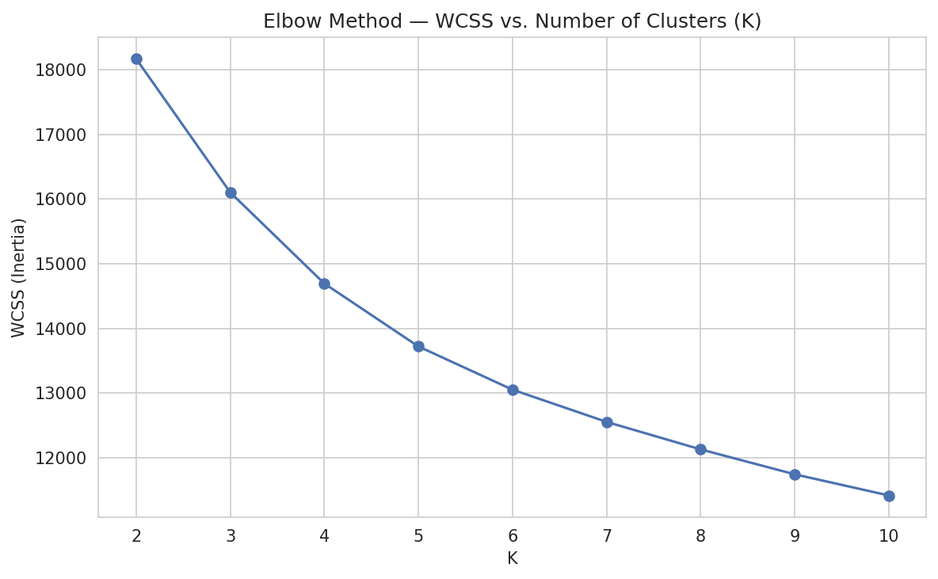
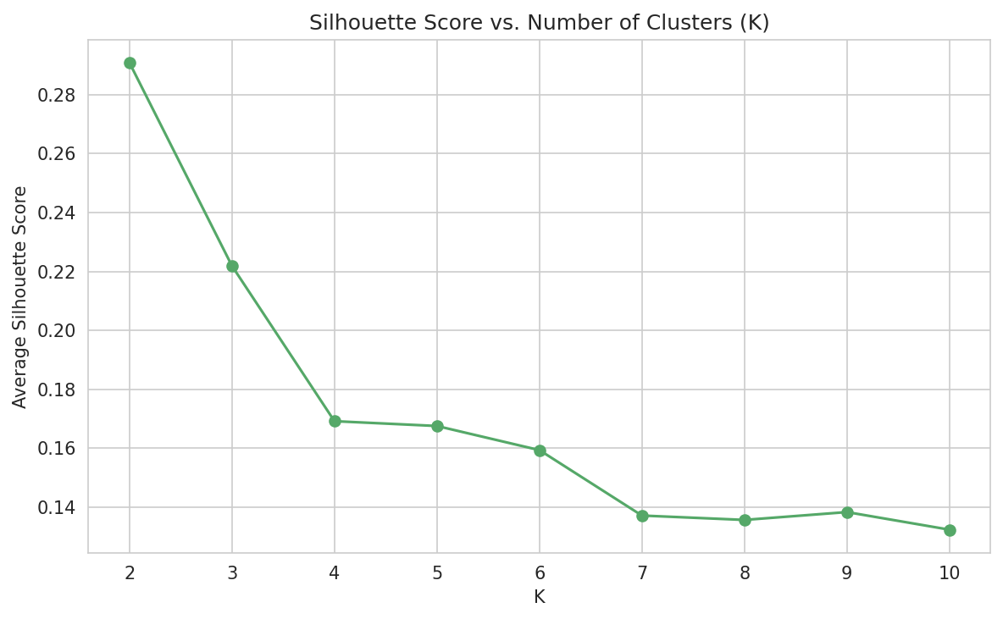
Determining the Optimal K
Statistical metrics vs. business interpretability
Silhouette & Davies-Bouldin statistically favor K=2; elbow suggests K=3. K=4 was chosen as a business-driven override to unlock actionable, named marketing personas.
ML-M06 — Customer Segmentation
3

Slide 4
Algorithm Comparison
K-Means selected as the production model
Algorithm | Silhouette | Davies-Bouldin | Time (s) | Handles Noise
K-Means | 0.169 | 1.890 | 0.017 | No
Hierarchical | 0.139 | 1.805 | 0.166 | No
GMM | 0.048 | 2.918 | 0.094 | No
DBSCAN | N/A | N/A | 0.128 | Yes
K-Means wins on Silhouette, Davies-Bouldin, and training speed — and its centroids are the easiest to explain to business stakeholders.
ML-M06 — Customer Segmentation
4

Slide 5
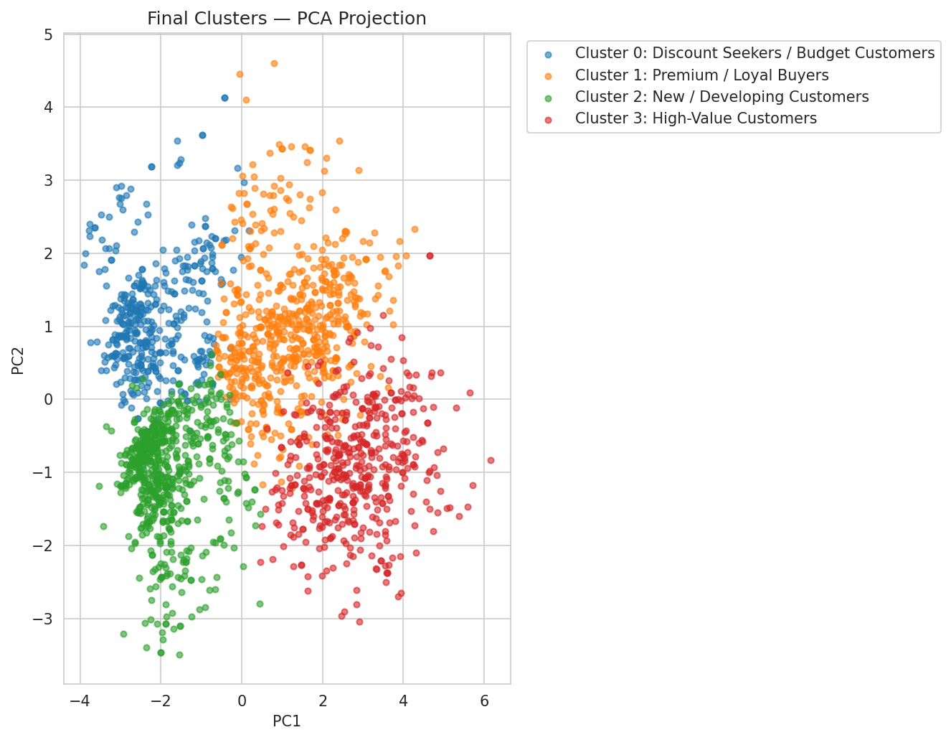
Four Customer Segments
PCA projection of the final K-Means clustering (K=4)
ML-M06 — Customer Segmentation
5

Slide 6
Segment Profiles
Cluster-wise averages
High-Value Customers
Premium / Loyal Buyers
22.1% of customers
28.6% of customers
Income $76,705 | Spend $1,430 | Campaigns 1.2
Income $59,927 | Spend $814 | Active on all channels
Discount Seekers / Budget
New / Developing Customers
19.1% of customers
30.2% of customers
Income $42,574 | Spend $131 | Largest families
Income $31,891 | Spend $105 | Youngest average age
ML-M06 — Customer Segmentation
6

Slide 7
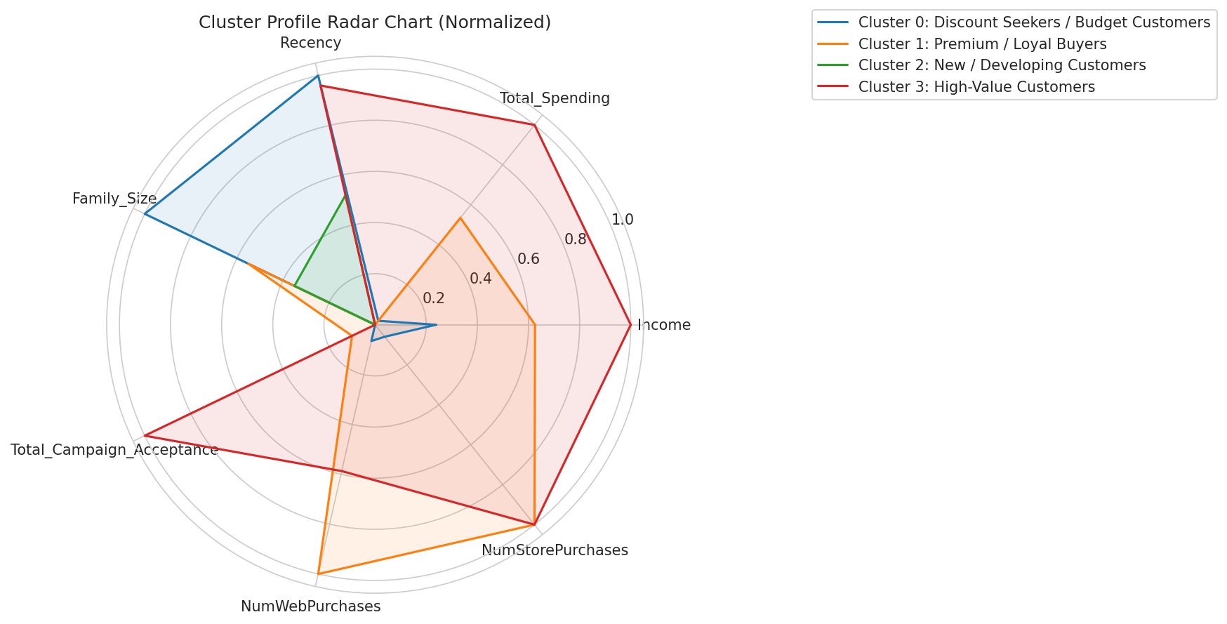
Cluster Profile Comparison
Normalized feature radar chart
ML-M06 — Customer Segmentation
7

Slide 8
Model Stability & Validation
The K=4 K-Means solution is highly reproducible
99.6%
95.7%
Random-State Consistency (avg ARI)
Bootstrap Sampling Stability (avg ARI)
Tested across 5 random seeds and 5 bootstrap resamples using Adjusted Rand Index (ARI).
ML-M06 — Customer Segmentation
8

Slide 9
Business Recommendations
High-Value Customers: premium bundles, early access, loyalty perks
Premium/Loyal Buyers: cross-sell across web, store & catalogue
Discount Seekers: value bundles & family-size promotions
New/Developing Customers: onboarding journeys & welcome incentives
Deploy the saved production pipeline to auto-segment new customers
ML-M06 — Customer Segmentation
9

